Slide 1

Sensor Kit (Kit 1)
ZAS Robotics Training

Slide 2



Sensor Kit - Contents
Sensor Kit Components
Sensor Creative Board

Slide 3



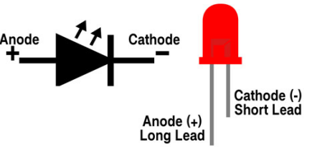

SFL01: SINGLE LED CONTROL
Things Needed

Slide 4
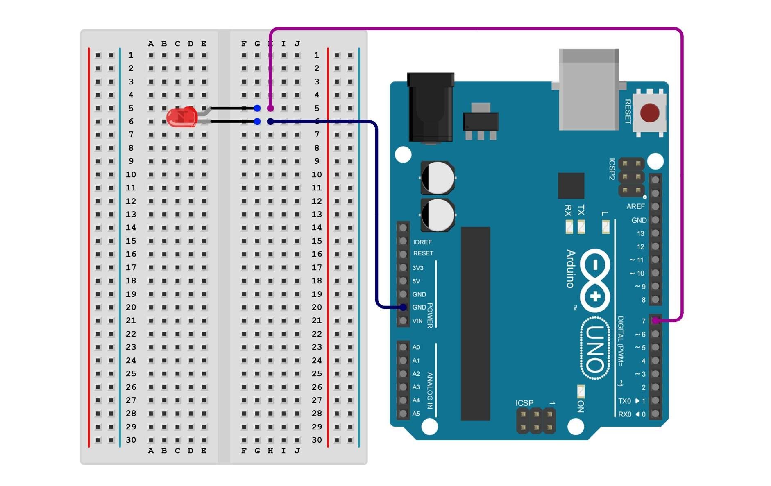
SFL01 : SINGLE LED CONTROL
Connections:
Arduino Pin | breadboard
GND(short end) | Blue line
Anode(long end) | Purple line

Slide 5
SFL01 : SINGLE LED CONTROL
Code for lesson SFL01:
https://github.com/info-zas/zas-robotics-sensors/blob/main/01_FoundationProjects/01_Code/_01_BlinkingLED/_01_BlinkingLED.ino
Controls an LED connected to Arduino Pin 7
Turns it ON for 1 second, then OFF for 1 second
Keeps repeating this forever

Slide 6
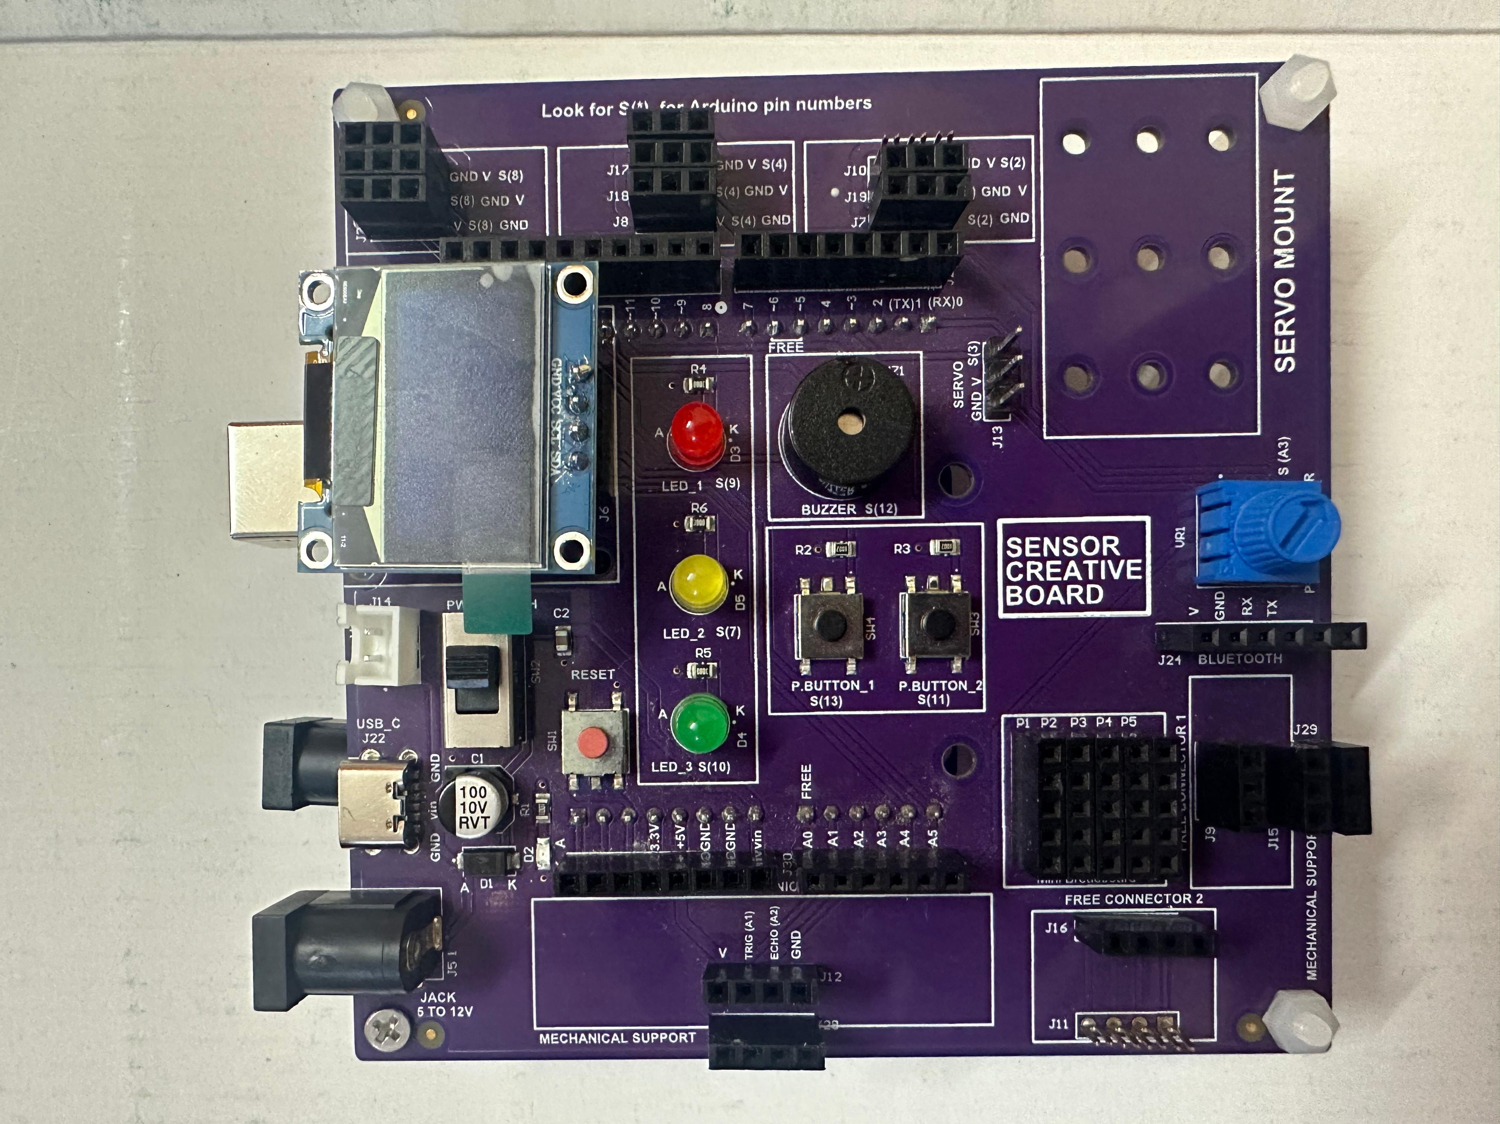
SFL01 : SINGLE LED CONTROL
(using creativity board)
The creative board already has built-in LED lights.
These LEDs are pre-connected to Arduino pins.
This setup removes the need for additional wiring.
The design prevents wire clutter and keeps the workspace neat.
It lets users focus more on the project rather than wiring.
Ideal for beginners learning Arduino without hassle.

